Slide 1

CAPSTONE PROJECT-1
EDA ON HOTEL BOOKING ANALYSIS

Slide 2
SUMMARY
For this project we will be analyzing Hotel Booking data. This data set contains booking information for a city hotel and a resort hotel, and includes information such as when the booking was made, is canceled or not canceled, market segment, country, the number of adults, children and babies and the number of available parking spaces.
Hotel industry is a very volatile industry and the bookings depends on above factors and many more.
The main objective behind this project is to explore and analyze data to discover important factors that govern the bookings and give insights to hotel management, which can confirm various campaigns to boost the business and performance.

Slide 3
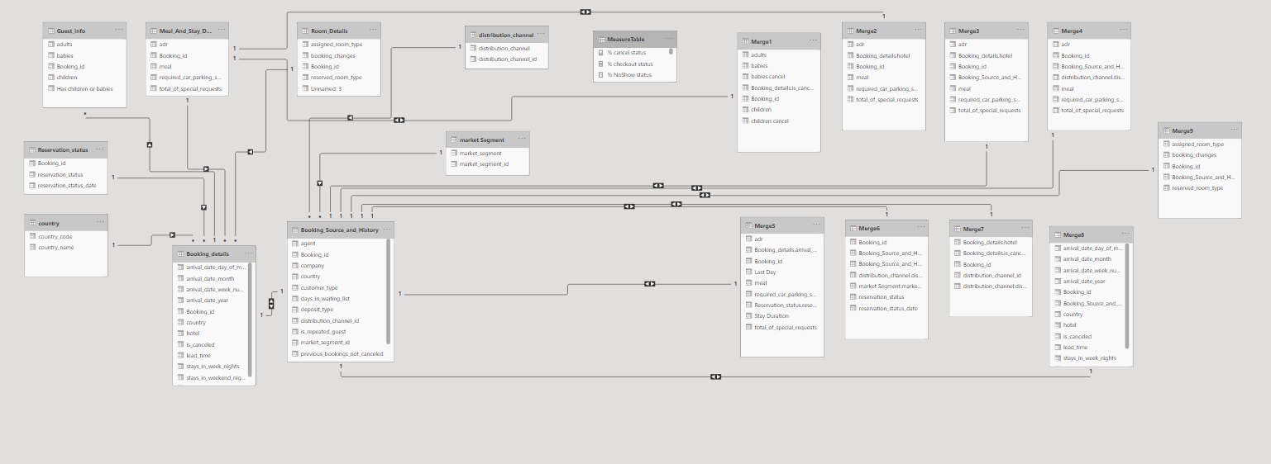
Data Modelling

Slide 4
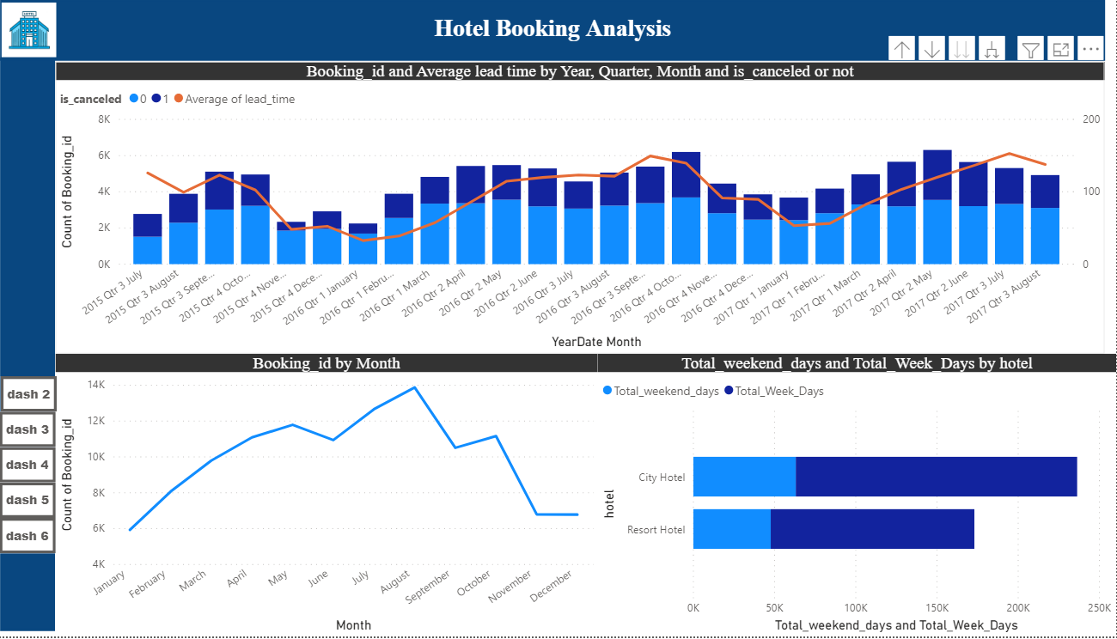

Slide 5
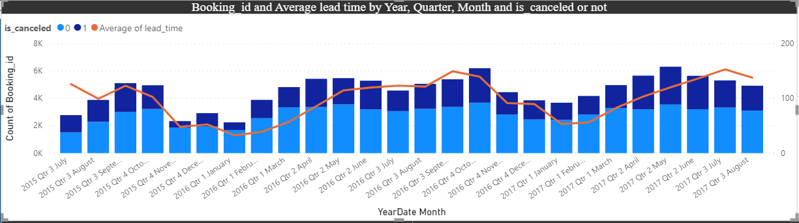
Visualize booking trends over the years, including the number of bookings, cancellations, and average lead time. Identify seasonality patterns. Visualizing the number of bookings over the years helps in understanding the overall demand for a service or product. It allows businesses to identify peak booking periods, low seasons, and any long-term trends. Analyzing this data can assist in resource planning, marketing strategies, and revenue forecasting. Monitoring the number of cancellations provides insights into customer behavior and satisfaction. A sudden increase in cancellations might indicate issues with customer experience, marketing messaging, or external factors. Seasonality refers to recurring patterns or fluctuations in data that happen at specific times during the year. Identifying seasonality patterns is crucial for businesses to anticipate and prepare for variations in demand. In summary, visualizing booking trends and identifying seasonality patterns is about extracting meaningful insights from historical data to make informed decisions. Businesses can use this information to enhance customer satisfaction, improve operational efficiency.
1. Visualize booking trends over the years, including the number of bookings, cancellations, and average lead time. Identify seasonality patterns.

Slide 6
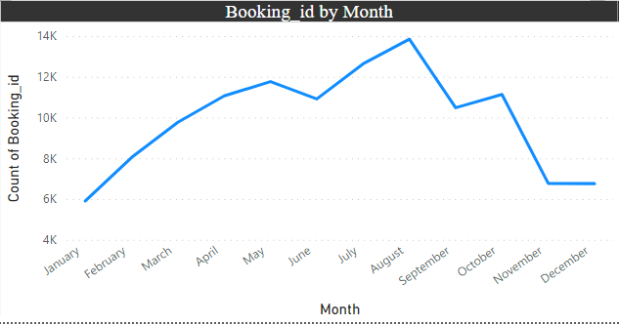
To form the chart I used a line chart and in the x axis I used year and in values count of booking id from the booking details table Identifying peak months allows businesses to focus their marketing efforts when demand is naturally higher, maximizing revenue potential. Knowing when demand is expected to peak helps in better resource planning, including staffing, inventory, and operational capacity. Tailoring marketing strategies to align with peak months enables businesses to engage with customers when they are more likely to make bookings. Optimizing marketing strategies based on historical booking patterns can provide a competitive advantage by ensuring that promotional efforts are well-timed and effective. In summary, analyzing monthly booking patterns and optimizing marketing strategies based on peak months is a data-driven approach to enhance business performance, increase customer acquisition, and improve overall marketing effectiveness.
2. Analyze monthly booking patterns to identify peak months and optimize marketing strategies.

Slide 7
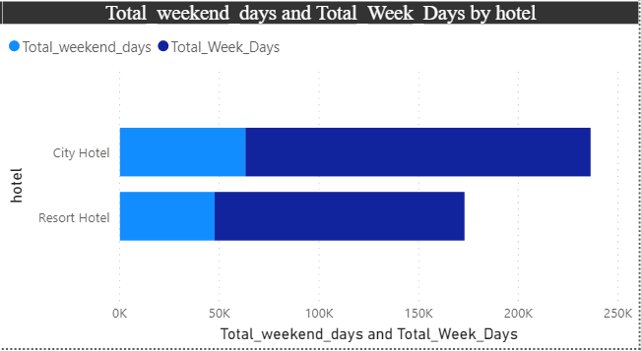
To form the chart I used a stacked bar chart and in the x axis I used hotel and in values total weekend days and total week days. Knowing guest preferences allows hotels to tailor marketing campaigns to specific audiences, promoting relevant offers and experiences. Understanding variations in stays helps hotels optimize staffing, services, and amenities to align with guest expectations on different days of the week. Aligning services with guest preferences enhances the overall guest experience, leading to higher satisfaction and potential repeat business. Hoteliers can make informed strategic decisions, such as pricing strategies, promotional activities, and partnerships based on when guests are most likely to book. In conclusion, comparing stays on weekend nights and weekday nights to determine preferences and variations by hotel type is a strategic analysis that enables hotels to tailor their offerings and services to meet the specific needs of their target audience. It provides valuable insights for marketing, operations, and overall business strategy.
3. Compare stays in weekend nights and weekday nights to determine preferences and variations by hotel type.

Slide 8
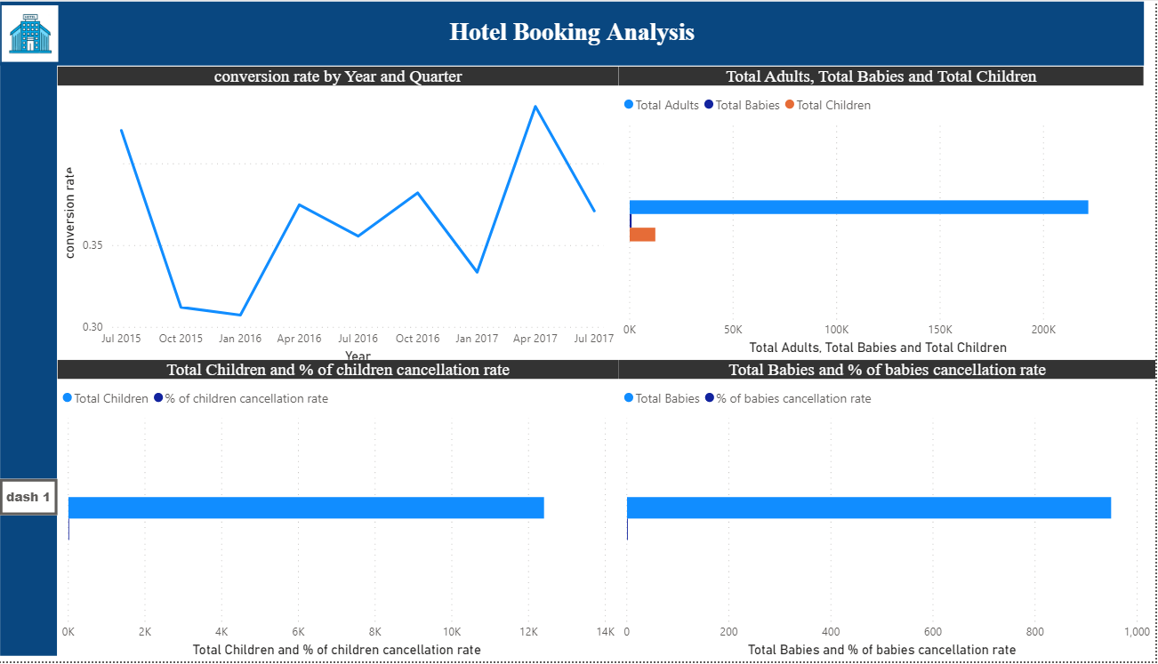

Slide 9
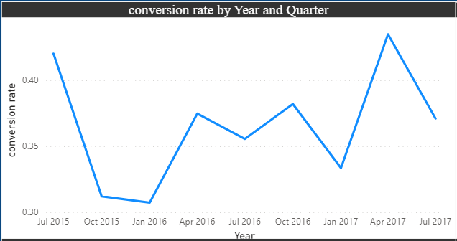
Understanding booking conversion rates provides insights into customer behavior, helping to anticipate and respond to changing preferences. In summary, calculating and visualizing the booking conversion rate over time is a valuable analysis for understanding customer behavior, optimizing operations, and making informed strategic decisions in the hospitality industry.
4. Calculate and visualize the booking conversion rate (canceled bookings to total bookings) over time.

Slide 10
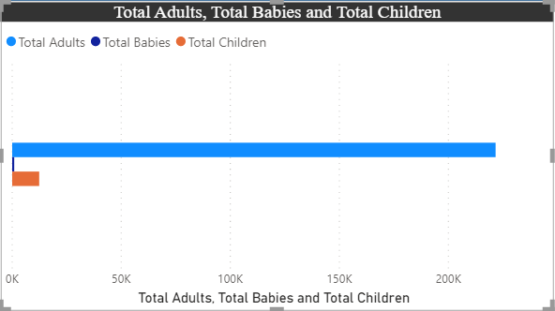
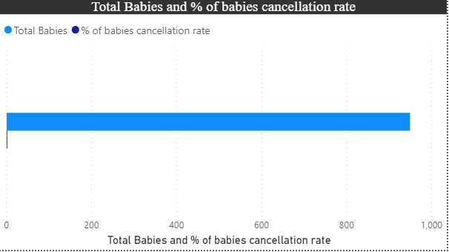
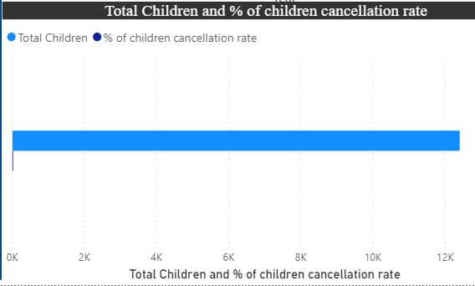
A higher cancellation rate for bookings with children or babies may suggest that guests with families are more likely to change plans or encounter unexpected circumstances. Alternatively, a lower cancellation rate may indicate that families plan more thoroughly and commit to their bookings. By visualizing the distribution of adults, children, and babies and exploring their impact on cancellation rates, businesses can gain valuable insights into guest behavior, leading to more informed operational decisions and improved guest satisfaction.
5. Visualize the distribution of adults, children, and babies in bookings. Explore the impact of children and babies on cancellation rates.

Slide 11
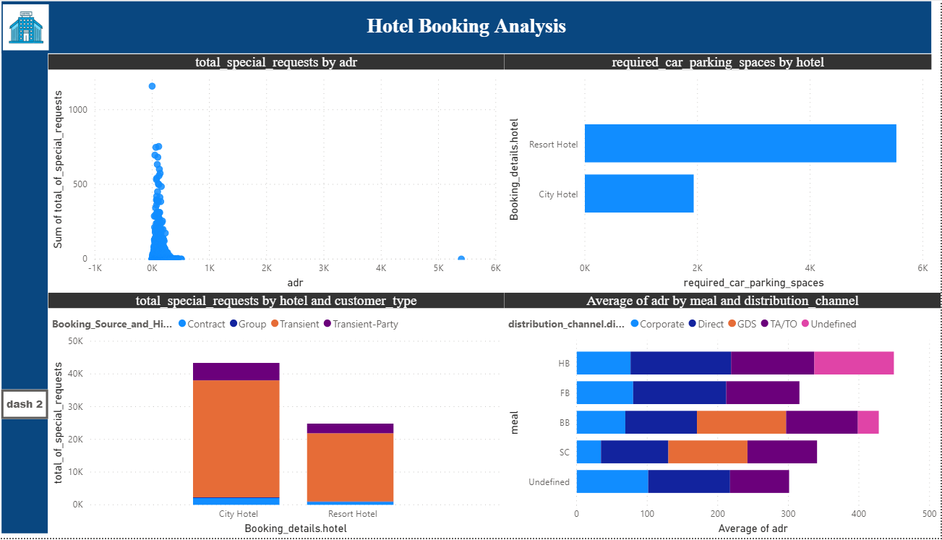

Slide 12
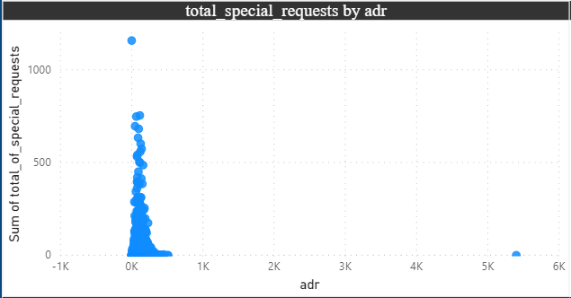
Understanding the correlation helps in refining pricing strategies. It allows businesses to adjust pricing based on the expected level of additional services requested by guests. The correlation provides insights into the types of services or amenities that guests may value based on their willingness to pay a higher ADR. In summary, analyzing the distribution of ADR and its correlation with the number of special requests provides valuable insights for pricing strategies, service customization, and overall guest satisfaction. Businesses can use this information to optimize their offerings and enhance the guest experience.
6.Analyze the distribution of Average Daily Rates (ADR) and identify correlations with the number of special requests made by guests.

Slide 13
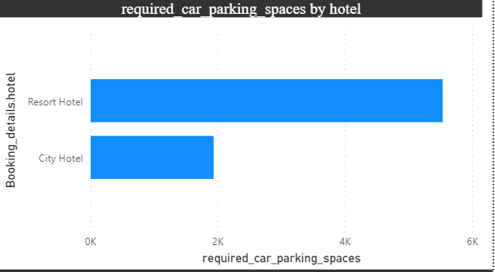
Knowledge of parking space requirements can be used in marketing and communication strategies. For example, Resort Hotels might emphasize spacious parking facilities in their promotions. For City Hotels, understanding parking needs is relevant to urban planning and coordination with local authorities. In summary, visualizing the relationship between the number of required car parking spaces and booking types provides insights into guest preferences and operational considerations. It allows hotels to tailor their services and infrastructure based on the parking needs associated with different hotel types.
7. Visualize the relationship between the number of required car parking spaces and booking types (Resort Hotel vs. City Hotel).

Slide 14
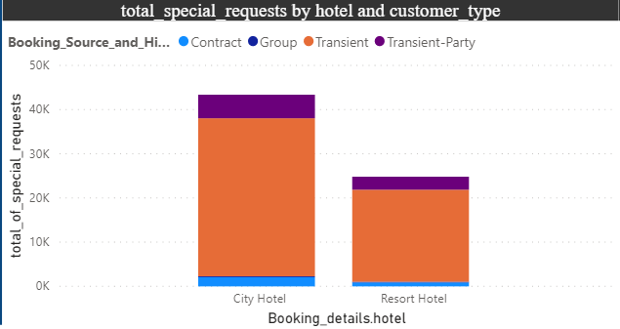
Meeting and exceeding guest expectations regarding special requests contributes to overall satisfaction. Efficiently allocating resources based on the types of special requests helps in operational efficiency. Understanding and responding to guest preferences can provide a competitive advantage in the hospitality industry. In conclusion, using Power BI to explore how the total number of special requests varies by hotel type and customer type is a powerful way to gain insights into guest behavior, allowing hotels to optimize services and improve overall guest satisfaction.
8. Use Power BI to explore how the total number of special requests made by guests varies by hotel type and customer type (e.g., Transient, Group).

Slide 15
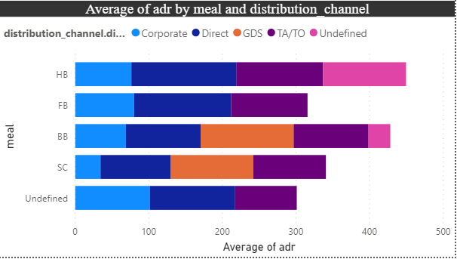
Understanding the impact of meal plans on ADR helps in setting competitive prices and maximizing revenue. Offering popular meal plans enhances guest satisfaction, as guests are more likely to choose plans that align with their preferences. Leveraging insights into meal plan preferences and their association with booking channels provides a competitive advantage in the hospitality market. In conclusion, exploring meal plans, their impact on ADR, and analyzing preferences in association with booking channels using Power BI helps hotels optimize pricing, enhance guest satisfaction, and tailor marketing strategies for increased efficiency and competitiveness.
9. Explore meal plans and their impact on Average Daily Rates (ADR). Analyze meal plan preferences and their association with booking channels.

Slide 16
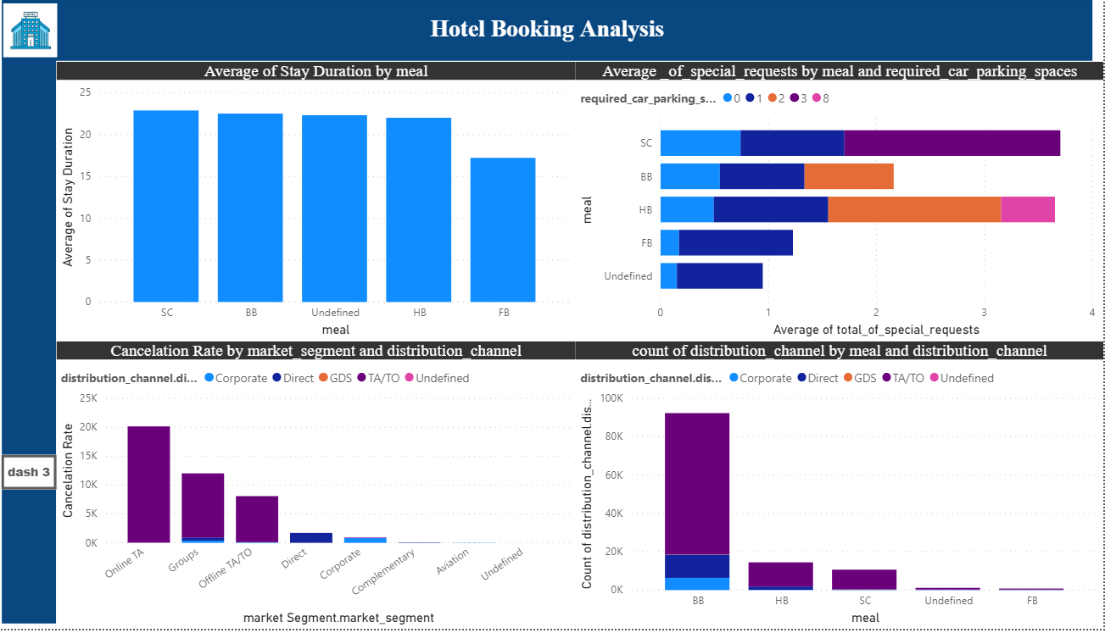

Slide 17
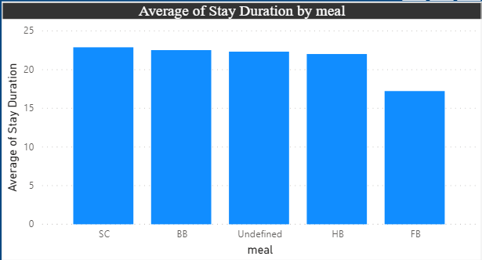
Understanding how meal plans correlate with stay duration aids in optimizing resources and services for different guest needs. If certain meal plans are associated with longer stays, this can impact revenue projections and allow for strategic pricing adjustments. In conclusion, analyzing how meal plans correlate with stay duration and investigating differences in stay lengths based on meal plans using Power BI helps hotels understand guest behavior, optimize operations, and tailor services to enhance guest satisfaction.
10. Analyze how meal plans correlate with stay duration and investigate any differences in stay lengths based on meal plans.

Slide 18
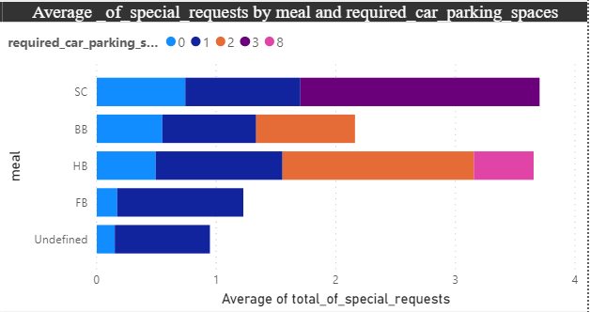
Efficiently managing parking spaces and resources based on meal plan preferences improves overall operational efficiency. The insights gained can inform marketing strategies, helping hotels target specific guest segments with tailored offerings. Understanding the correlation allows hotels to customize services for guests based on their meal plan choices, leading to higher guest satisfaction. In conclusion, correlating parking requirements and special requests with different meal plans using Power BI helps hotels gain insights into guest behavior, optimize operations, and enhance overall guest satisfaction by aligning services with meal plan preferences.
11. Correlate parking requirements and special requests with different meal plans. Determine if certain meal plans result in more requests or parking needs.

Slide 19
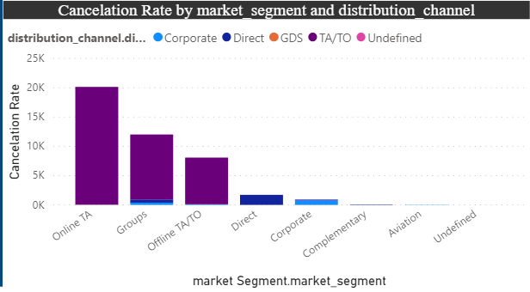
Efficiently targeting marketing efforts by aligning promotions with meal plans preferred by guests from different channels improves marketing efficiency. The insights gained can inform strategic decisions related to pricing, promotions, and overall hotel management. Leveraging knowledge about meal plan preferences associated with booking channels provides a competitive edge in the hospitality industry. In conclusion, exploring how meal plans are distributed across various booking channels and analyzing associations between channels and specific meal plans using Power BI helps hotels tailor their services and marketing strategies to meet guest preferences and improve overall operational efficiency.
12. Explore how meal plans are distributed across various booking channels. Analyze if certain channels are associated with specific meal plans.

Slide 20
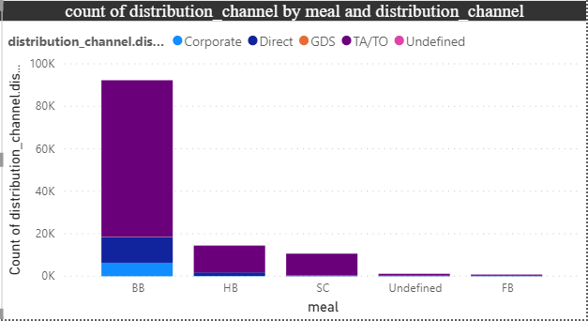
Knowing the distribution of bookings across market segments helps in targeted guest outreach and ensures that marketing efforts align with the preferences of specific segments. Identifying segments with higher cancellation rates allows hotels to implement strategies to mitigate cancellations, such as flexible cancellation policies or targeted retention efforts. The insights gained can inform strategic decisions related to pricing, promotions, and overall hotel management. In conclusion, visualizing booking distribution across different market segments and analyzing cancellation rates within each segment using Power BI helps hotels tailor their services, marketing strategies, and operational planning to meet the preferences and behaviors of guests in different segments, ultimately improving overall efficiency and guest satisfaction.
13. Visualize booking distribution across different market segments and analyze cancellation rates within each segment.

Slide 21
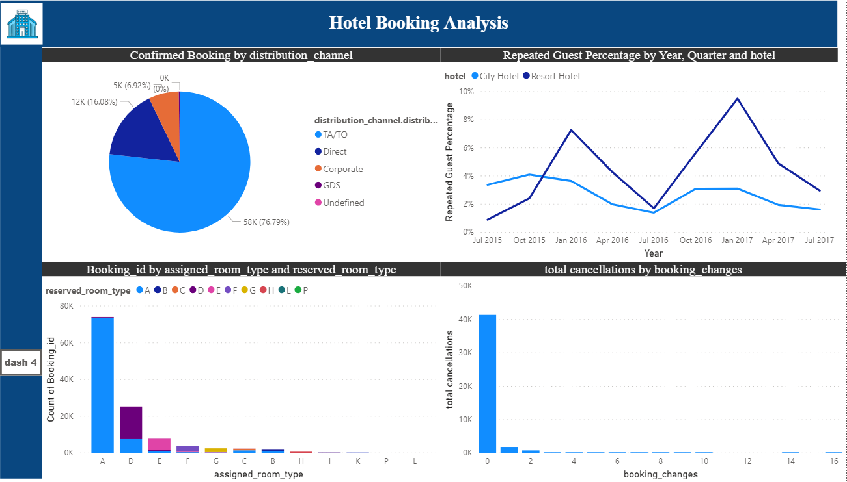

Slide 22
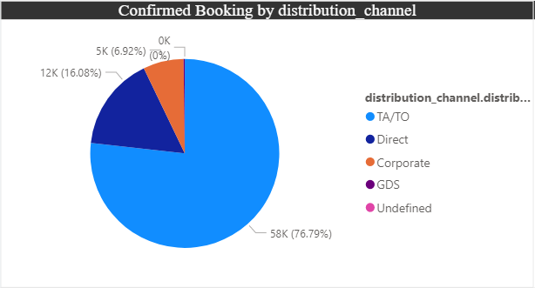
Knowing which booking channels are most effective allows hotels to allocate resources efficiently, whether it be marketing budgets or staff efforts. Efficiently targeting marketing efforts by focusing on high-performing channels improves the overall efficiency of promotional campaigns. Leveraging knowledge about effective booking channels provides a competitive advantage in the market. In conclusion, comparing the effectiveness of booking distribution channels in generating confirmed bookings using Power BI helps hotels optimize marketing strategies, enhance guest experience, and allocate resources efficiently, ultimately contributing to revenue growth and competitive advantage.
14. Compare the effectiveness of booking distribution channels in generating confirmed bookings. Identify the most commonly used channels by guests.

Slide 23
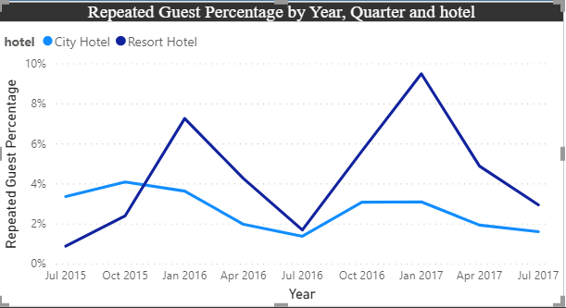
Monitoring guest retention over time helps in effective guest relationship management, allowing hotels to nurture and maintain relationships with repeat guests. Understanding factors influencing retention allows hotels to improve guest experience and tailor services to meet the expectations of repeat guests. Leveraging knowledge about guest retention provides a competitive advantage, helping hotels stand out in the market. In conclusion, visualizing the percentage of repeated guests for each hotel type over time using Power BI allows hotels to gain insights into guest loyalty, identify successful retention strategies, and adapt their approach to improve overall guest satisfaction and loyalty.
15. Visualize the percentage of repeated guests for each hotel type (Resort Hotel vs. City Hotel) over time. Explore factors influencing guest retention.

Slide 24
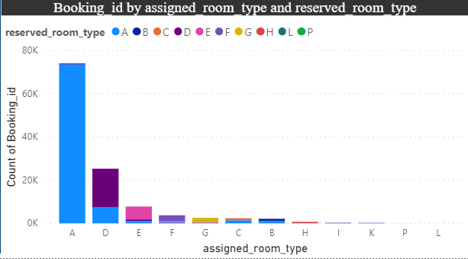
Ensuring that guests receive the room type they reserved contributes to an enhanced guest experience, aligning the hotel's offerings with guest expectations. Consistent alignment between reserved and assigned room types is a key indicator of the hotel's commitment to providing quality services. Monitoring room assignment alignment allows hotels to continuously improve their processes and systems to meet guest expectations. In conclusion, visualizing the distribution of reserved and assigned room types using Power BI and analyzing the alignment between these types helps hotels understand how well they meet guest expectations. This analysis contributes to enhancing guest satisfaction, improving operational efficiency, and ensuring the overall quality of the guest experience.
16. Visualize the distribution of reserved and assigned room types. Analyze whether guests tend to receive the room type they initially reserved.

Slide 25
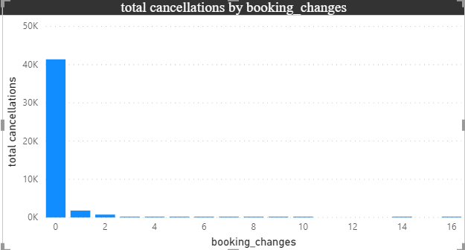
Understanding the relationship between booking changes and cancellations helps hotels make informed decisions about policies, procedures, and customer communication. Insights into guest behavior around booking changes contribute to optimizing services and providing a better overall guest experience. In conclusion, investigating the relationship between the number of booking changes made by guests and their likelihood of canceling a booking using Power BI allows hotels to understand guest behavior patterns. This analysis assists in making operational decisions, optimizing services, and tailoring communication strategies to enhance the overall guest experience and mitigate risks associated with cancellations.
17. Investigate the relationship between the number of booking changes made by guests and their likelihood of canceling a booking.

Slide 26
Around 60% bookings are for City hotel and 40% bookings are for Resort hotel, therefore City Hotel is busier than Resort hotel. Also the overall adr of City hotel is slightly higher than Resort hotel. Mostly guests stay for less than 5 days in hotel and for longer stays Resort hotel is preferred. Both hotels have significantly higher booking cancellation rates and very few guests less than 3 % return for another booking in City hotel. 5% guests return for stay in Resort hotel. Most of the guests came from european countries, with most no. of guest coming from Portugal. Guests use different channels for making bookings out of which most preferred way is TA/TO. For hotels higher adr deals come via GDS channel, so hotels should increase their popularity on this channel. Almost 40% of bookings via TA/TO are cancelled. Not getting same room as reserved, longer lead time and waiting time do not affect cancellation of bookings. Although different room allotment do lowers the adr. July- August are the most busier and profitable months for both of hotels. Within a month, adr gradually increases as month ends, with small sudden rise on weekends. More number of people in guests results in more number of special requests. Bookings made via complementary market segment and adults have on average high no. of special request. For customers, generally the longer stays (more than 15 days) can result in better deals in terms of low adr.
Conclusions

Slide 27
Thank You

